Slide 1
PRESENTED BY:MATHUMITHA M REGISTER NO:962821205033 DEPARTMENT:INFORMATION TECHNOLOGY
AI Art Generator using Autoencoder algorithm
3/21/2024 Annual Review

Slide 2
PROJECT TITLE: AI Art Generator using Autoencoder algorithm
3/21/2024 Annual Review

Slide 3
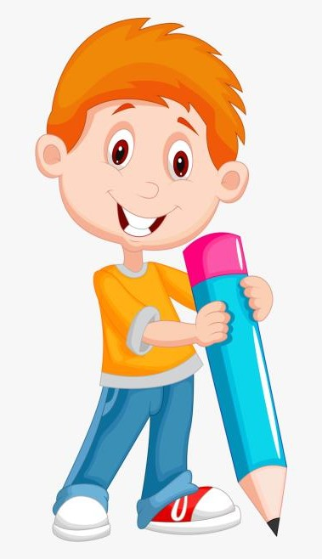

AGENDA
Introduction
Problem Statement
Project Overview
Solution and Value Proposition
The Wow in Our Solution
Modelling
Results
Conclusion
3/21/2024 Annual Review

Slide 4

PROBLEM STATEMENT
Current AI Art Generators Lack Accessibility and Control for Specific Creative Needs.
One fascinating application is the generation of artwork by AI systems.
AI art generator capable of producing novel and visually appealing images across different artistic styles.
Design and implement an AI art generator that autonomously creates high-quality and diverse artworks across various styles, genres, and themes.
3/21/2024 Annual Review

Slide 5
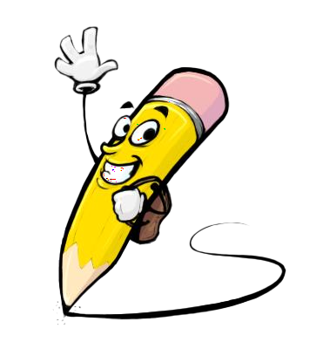
PROJECT OVERVIEW
Introduce the project and its significance in the context of AI, art, and creativity.
Conduct a literature review on existing techniques and methodologies for AI art generation, including GANs, VAEs, and style transfer.
Gather a diverse dataset of art images covering various styles, genres, and themes.
Choose an appropriate deep learning architecture, such as GANs, VAEs, or a combination, based on project requirements and research findings.
Implement the training pipeline using frameworks like TensorFlow.
Develop a user-friendly interface for interacting with the AI art generator, allowing users to specify preferences, explore generated artworks, and provide feedback. Incorporate features for controlling aspects like style transfer strength, content selection, and image editing.
3/21/2024 Annual Review

Slide 6

WHO ARE THE END USERS?
Professional artists and creators
Graphic designers, illustrators, and other design professionals.
Teachers and students in art schools, universities, or online courses
Companies in industries such as advertising, marketing, gaming, and entertainment.
The general public
3/21/2024 Annual Review

Slide 7

YOUR SOLUTION AND ITS VALUE PROPOSITION
AI art generators empower artists and creators by providing them with an endless source of inspiration and novel artistic possibilities. By leveraging advanced algorithms and generative models, these tools can assist artists in exploring new styles, techniques, and visual concepts, thus amplifying their creative potential.
Instantly generate beautiful artworks whenever you need them, saving time and effort while sparking your creativity.
AI art generators democratize the creative process by making art creation more accessible to individuals with varying levels of artistic expertise.
AI art generators encourage innovation and experimentation in the intersection of art and technology.
Experience the joy of artistic expression and discovery as you interact with the AI art generator, generating excitement and delight with each new creation.
3/21/2024 Annual Review

Slide 8

THE WOW IN YOUR SOLUTION
Experiment with real-time previews to find the perfect combination, making art creation a delightful exploration.
Our AI art generator produces captivating artworks in seconds, eliminating the need for lengthy manual creation processes.
Democratize art creation by making the joy of artistic expression accessible to everyone.
3/21/2024 Annual Review
8

Slide 9
MODELLING
Generative Adversarial Networks (GANs):
Two neural networks compete: a generator creating images, and a discriminator evaluating them against real art.
Over time, the generator learns to create images that fool the discriminator, resulting in realistic and creative outputs.
Popular GAN models for AI art generation include Stable Diffusion and DALL-E 2.
Variational Autoencoders (VAEs):
These models learn a compressed representation (latent space) of image data.
Users can manipulate this latent space to control aspects of the generated art like style, color, and composition.
VAEs offer more user control compared to traditional GANs.
Hybrid Approaches:
Style Transfer: Combine techniques from style transfer models with GANs or VAEs to allow users to control the style of generated images.
Conditional Generation: Incorporate additional conditioning information, such as class labels or user preferences, to generate images with specific attributes or styles.
3/21/2024 Annual Review
9

Slide 10
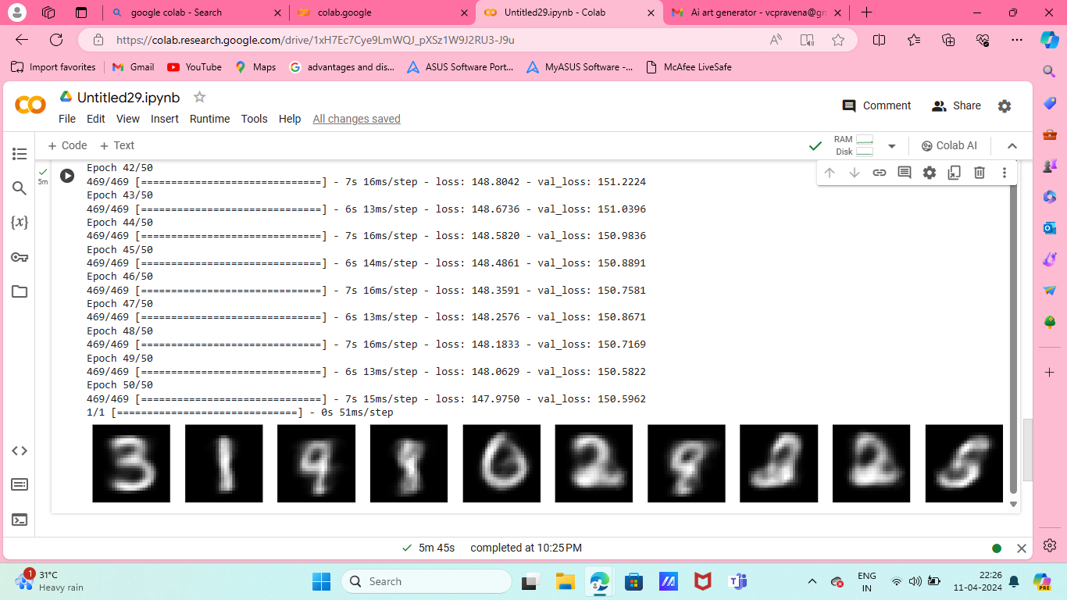
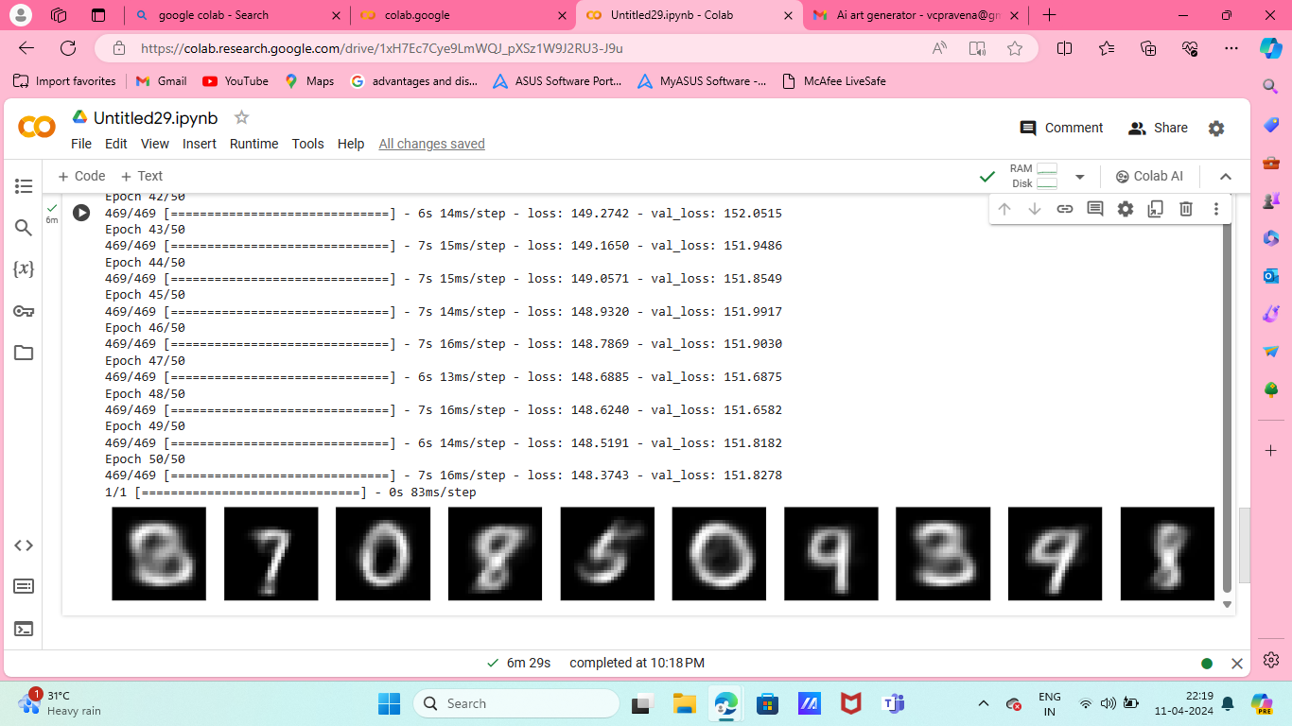
RESULTS
3/21/2024 Annual Review
10

Slide 11
CONCLUSION
Easy Art AI bridges the gap between AI and artistic expression.
Our project is user-friendly interface empowers everyone to create stunning art through style selection, color palettes, and intuitive tools.
Artists gain control and explore new avenues, while non-artists discover their creative potential.
Consistent, high-quality results ensure your vision comes to life.
Easy Art AI: AI art creation, for everyone.

